Slide 1
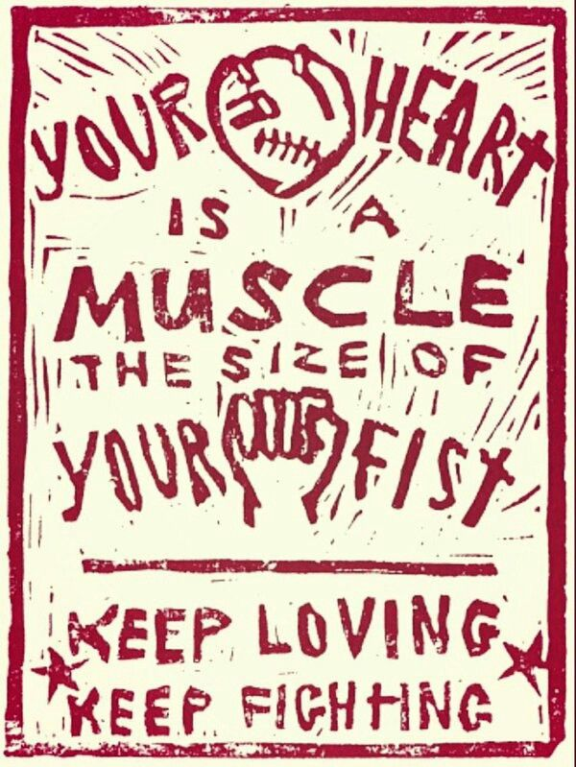
First Aid Concepts for Movement-Builders
an introduction to bleeding control
April Rosenblum
art: Dalia Sapon-Shevin

Slide 2
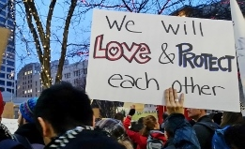
As community activists & organizers, we know so much about how to keep our people safe & protect each others’ lives.
Bleeding control should be second nature to us too. But topics like this can seem overwhelming.
Let’s use life skills we already know to make it easy to remember steps for bleeding control.
photo: Roberta Ray

Slide 3
Before we begin…
This isn’t a 1st aid course. It’s an introduction to the logic of how bleeding control works, so that any situation you find yourself in makes more sense to you. It’s easier to remember steps when we understand why they work.
We’re using metaphors about movement-building here because these ideas already make sense to many of us. Don’t interpret these metaphors as precise truths about physiology. I’m not a physician or an expert in bleeding control – just an engaged volunteer. Since I may update or correct this, please share it as a link, not an attachment: aprilrosenblum.com/firstaid
For recommended classes & supplies, see last page.

Slide 4
Q: Why can we lose too much blood
in just a few minutes?
A: Our hearts are powerful!
Our heart pushes blood so powerfully, it takes strength to hold it back. Applying pressure is the way we stop bleeding & help a healthy blood clot form.
When we have tools – like tourniquets, gauze & pressure bandages – they create pressure, freeing our hands up to do more. If you don’t have tools, hands alone can work.

Slide 5
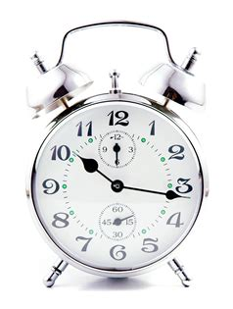
We don’t wait for leaders to save us
Bleeding control is like social change. It works if regular people take action.
If someone’s bleeding a lot, call right away for medical help. But do not wait for help to arrive.
Start applying pressure immediately & don’t let up until help arrives, or a new tool is ready.

Slide 6
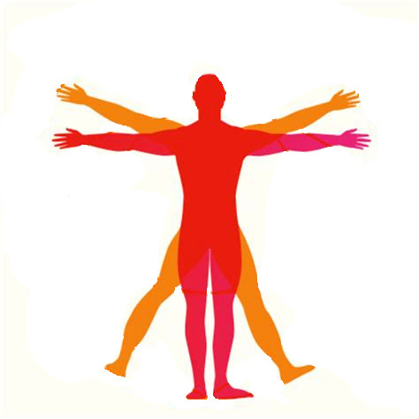
There are times when quick fixes make a big difference.
When you scan someone for bleeding, check their arms & legs
first.
It’s easy to make a difference here.
Many tools work on arms & legs.
apply pressure
ASAP if available: commercial tourniquet(s) as tight as possible; if bleeding continues add a 2nd one
wound packing
DIY tourniquet if necessary to free your hands
arms
legs

Slide 7
But the more “central” a problem is, the fewer quick fixes we have.
Points of connection to the body* include:
neck
armpits
groin
neck
At connection points to the body, use:
wound packing
direct pressure
armpits
groin
*aka “junctional points”

Slide 8
Problems that are central to the system need to be addressed in deeper ways.
Quick fixes for bleeding in the torso are limited.
We have one main tool:
direct pressure
And we can cover chest wounds to keep air out.
Do use pressure…
But get this person higher level medical care ASAP.
chest
stomach*
*aka abdomen

Slide 9
Look for the root cause.
Don’t be afraid to get messy. Stick your hand in an open wound (w/ gloves if you have them). Feel for where blood is pulsing. That’s the source of the problem.
Don’t use “band-aid solutions” (ie, covering a wound w/ towels so you can’t see where blood’s coming from)…if instead you can find the pulsing vessel, clamp it shut with your fingers (press it against the bone, for example) or aim gauze right at the source of flow & press there.

Slide 10
Bleeding: To know if it bleeding is severe, picture a hose. If you turn a hose off, it might still trickle or drip for a while; that’s minor bleeding. Severe bleeding is like a hose that’s been left on: it doesn’t stop; it might grow in a puddle, pour, or spray/spurt like a sprinkler.
Pressure: You can use your fingers (clamping a pulsing blood vessel shut), both hands (you can lean your full body weight into your hands while pushing against a wound), gauze/fabric (fill up the whole wound with it to create pressure) or a commercial or DIY pressure bandage. (After packing a wound & adding on extra material, you’ll wrap a bandage, fabric, etc., tightly around the injured area & tuck or fasten it, so that it keeps on holding pressure after you let go.) Pressure – from a person or a tool – needs to stay on until help arrives.
Tourniquets: When an arm or leg is bleeding severely, tourniquets put pressure between the injury and the torso, so that blood can’t get to the opening. Tourniquets are safe & important for severe bleeding, but should NOT be used for minor bleeding. Buy them commercially if possible, as DIY ones are not as good. Warn the person it will hurt – then place at least 2 inches closer to the torso & make as tight as possible. Note the time; it can safely be left on for hours. Even if it hurts, never loosen or undo – only a medical expert should do that.
Wound Packing: If you can fit a finger or two into a wound, you can pack it. Take gauze or clean fabric, ball up the end & push it into the deepest or most pulsing area of the wound. While keeping pressure on the gauze, feed more and more gauze into the wound, until you can’t fit any more in. Then either keep holding pressure on the wound by hand, or add more material over it and bandage tightly around it so the bandage keeps up the pressure. Don’t change bloody gauze; it needs to stay in place to form a clot. Just add on to it.
…Now sign up for a #StopTheBleed course!
Glossary & Tips:

Slide 11
Recommended 1st aid supplies:
Prices as of fall 2020
Things to order online:
I recommend buying multiples of everything if you can afford it. You may need more than one in an emergency, & if you have extra & can share it with others, everyone will be more prepared to care for each other.
Celox gauze – Special gauze, *helps blood to clot* (aka hemostatic) – Price varies by size of package
Stretch, Wrap and Tuck (SWAT-T) tourniquet – around $11 USD
This has multiple uses (it can be a pressure bandage, too) and unlike most tourniquets, it will work for kids.
CAT Tourniquet by North American Rescue – around $30 USD
Things found at home or in local stores:
Belt bag/waist pack – 1st aid is best carried on your body, not in a backpack, etc., which you might get separated from.
Mylar blanket – Wrap this around someone to warm them as treatment for shock, a dangerous condition which can follow blood l
Small scissors (nail-scissors size, etc) – Cuts gauze/bandage material. Many 1st aid kits have one made for this.

Slide 12
Recommended Classes:
Tips here were compiled from #StopTheBleed classes taught by the Red Cross, First Care Providers & Prep Medic. Not all courses agree with each other, but they all will help you make a difference.
Red Cross 30-minute online course – $30
Clear & concise; designed to be memorable; less detailed explanations.
First Care Providers free course
Still under an hour; requires a longer attention span; more in-depth explanations.

Slide 13
Learning bleeding control helps us to reject perfectionism.
When someone’s bleeding severely, the only thing you can get wrong is to not act at all, or to wait too long. Let’s get everyone we know to learn the basics of bleeding control, so no matter what happens, we can
art: Dalia Sapon-Shevin

